Slide 1
Report from Italy during the time of
SARS-CoV-2
(Apologies to Gabriel Garcia Márquez)
John H. Holmes, PhD
Professor of Medical Informatics in Epidemiology
University of Pennsylvania Perelman School of Medicine
Visiting Professor, University of Pavia, Italy

Slide 2
Some basic facts
SARS-COV-2 is a novel coronavirus, similar to what we see with SARS and MERS, but it has never been identified before the outbreak in Wuhan, China
COVID-19 is not the virus, but the disease caused by it
  Recently determined by the WHO to be a pandemic

Slide 3
Features of COVID-19
In most people, it causes few, if any symptoms
  Data from a town in Italy indicate 60-70% of those testing positive are asymptomatic throughout their course
In others, the disease is devastating
  Cascade of system compromise, involving lungs, heart, kidneys

Slide 4
Emerging symptomatology of COVID-19
The list of possible symptoms is growing with more experience and additional case reports, but include
    Fever (typically high, 101-103F)
    Dry cough
    Chest discomfort
    Headache (new)
    Low-grade fever (new)
    Sore throat (new)
    Hyposmia, dysgeusia, and ageusia (within this week)

Slide 5
Treatment of COVID-19:
In the early stages…
Until someone tests positive, assume one with symptoms is positive and self-quarantine.

Slide 6
As COVID-19 progresses
Most (~80%) will experience a flu-like syndrome that lasts 10-14 days and can rest at home (in quarantine, of course!)
Others (elders, immunocompromised, those with significant comorbidities)
  Usually hospitalized after triage
    Most will be discharged after 7-10 days to quarantine at home
    Some will end up in the ICU

Slide 7
Triage tents
https://rep.repubblica.it/pwa/generale/2020/03/17/news/coronavirus_il_grido_delle_marche_due_calamita_in_tre_anni_ora_rischiamo_il_collasso_-251569899/

Slide 8
Trajectory for the hospitalized
Observation
  Ongoing clinical assessment
  Pulse oximetry
  Nasal O2 with mask, non-rebreathing mask if needed, but (next slide….)
  Fluid resuscitation as needed
  Chest films (some using CT)
  Blood gases and chemistries
  Recovery after weeks for most of the 20%
  Antibiotics
Transfer (or direct admit) to the ICU

Slide 9
What is happening…
Bilateral interstitial pneumonia
  Disseminated alveolar inflammation
    Prevents alveoli from expanding
  Arterial paO₂ can fall to extremely low levels (<40mmHg) and the FiO₂/paO₂ ration is high
  Lung imaging characterized by scarring and consolidation

Slide 10
In the ICU
Ramp up O₂ support
  Non-rebreathing mask
  Intubation and mechanical ventilation with high levels of PEEP
  ECMO (Extracorporeal Membrane Oxygenation)
Antibiotics
Organ systems monitoring
Pronation

Slide 11
Ultimately
Possible recovery, but with severe scarring of the lung and reduced pulmonary function in some
Death due to organ system failure
  In many cases, fulminant myocarditis

Slide 12
What it’s like inside an ICU here
https://www.la7.it/piazzapulita/video/coronavirus-dentro-il-reparto-di-terapia-intensiva-05-03-2020-311522
And here is a video:
https://www.youtube.com/watch?v=rfkbv_WQtn0

Slide 13
To bring everyone up to speed on the epidemiology
Epidemiologists and public health professionals are using tools to identify, contain, and mitigate the spread
Epidemic curves are indispensable in understanding the incidence and the rate of transmission
  Can inform inference about mode of transmission, identification of hot spots, development of containment and mitigation policies and procedure, and resource allocation

Slide 14
Comparing epidemic curves
https://www.statista.com/chart/21112/covid-19-growth-curve-selected-countries/

Slide 15
Where we are now globally
https://www.worldometers.info/coronavirus/

Slide 16
What is this
“Flattening the Curve” all about?
How do we accomplish this? Social Distancing

Slide 17
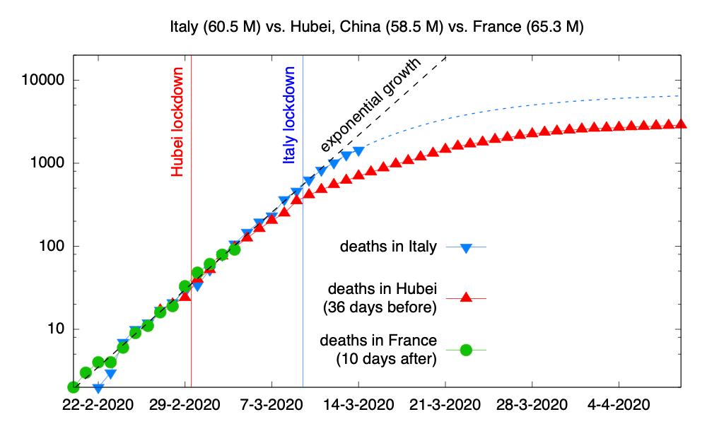
The effect of social distancing on incidence

Slide 18
Let’s compare the curves…
https://www.visualcapitalist.com/infection-trajectory-flattening-the-covid19-curve/

Slide 19
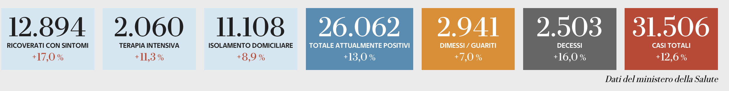
So, back to Italy
All indicators continue to climb
  Number recovering with symptoms
  Number of patients in ICU
  Number on home quarantine
  Number of currently positive patients
  Number dismissed from care and cured
  Number of decedents
  Total number of cases since testing started
https://lab.gedidigital.it/gedi-visual/2020/coronavirus-i-contagi-in-italia/?ref=RHPPTP-BH-I250745935-C12-P8-S1.3-T1

Slide 20
What is happening here
Country-wide shutdown (March 9)
  All cafes, bars, restaurants, places of business, non-essential government offices
  Food markets, pharmacies, and newsstands exempted
Effect on daily life
  “Stay-home” order
    No movement outside the home is allowed except for specific purposes
    No visits with friends or family
    The streets are literally, and spookily, empty
  Severe economic impact
Effect on healthcare
  DRAMATIC shortages of ICU beds and staff
  Shutdown of elective admissions and surgery
  Drain on acute care resources for other health outcomes, such as MI, CVA, other infectious disease, etc.

Slide 21
About the “stay-home” order
You have to fill out an “autodichiarazione” that indicates who you are, where you’re coming from, where you’re going, and the reason for being out
  Work (not all work is accepted, healthcare is)
  Needing healthcare
  “Necessaries” (food, medications, etc.)
You have to swear and sign the form to verify the above, plus a new clause that you are not positive, and you are not under quarantine orders (because you came into contact with a positive)
Penalties: 210 € and/or three months in jail
  If you are positive or under quarantine and you make a false statement, 4-12 years in prison

Slide 22
These guys mean business…
https://laprovinciapavese.gelocal.it/pavia

Slide 23
So do these…
https://laprovinciapavese.gelocal.it/pavia

Slide 24
Let’s open this up for discussion!

